Slide 1
Project: Dataset Visualization
Group 7
Rasmus Serrestam

Slide 2
Business Understanding and Data
Business objective
Build an interactive dashboard to explore video game sales and show differences between markets.
Main questions
Which platforms and genres perform best in different regions?
How have sales and platform popularity changed over time?
Which games have the highest reported worldwide sales?
Which publishers and platforms show strong sales performance?
Dataset overview
Main dataset: vg_charts.csv
64,016 rows and 14 columns in the supplied CSV.
Key attributes: title, platform, genre, publisher, developer, critic score, regional sales and release date.
Supporting datasets include developer, publisher and geographic information.

Slide 3
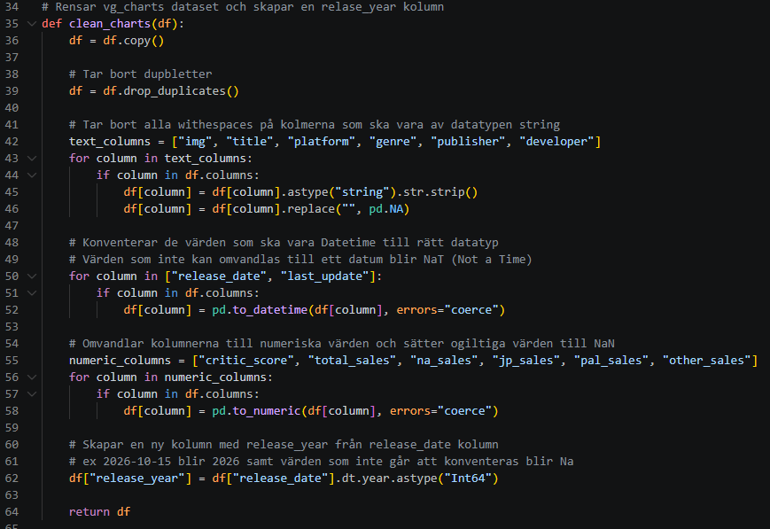
Data Preparation
How we prepared the data
Remove duplicates using drop_duplicates().
Clean text columns by removing surrounding whitespace and converting empty strings to missing values.
Convert dates using pd.to_datetime().
Convert sales and critic scores to numeric data types using pd.to_numeric().
Create release_year from release_date to support time-based analysis.
Values that cause errors are converted to NaN

Slide 4
Interactive Dashboard and Visualization
From data to insights
Our Dash application uses interactive visualizations to explore:
Regional sales differences.
Platform and genre popularity.
Sales trends by release year.
Top-selling games and publisher performance.
Visualization choices
Bar charts: Compare platforms, genres and games.
Line charts: Examine changes in sales and popularity over time.
Interactive filters: Focus on particular platforms, regions, genres or years where supported by the application.
Tooltips: Inspect individual values without overcrowding the charts.

Slide 5
Live Demo

Slide 6
Key Findings
1. Regional differences
North America has the largest sum of reported regional sales
Sports is the leading genre by reported sales in North America.
Role-playing games lead by reported genre sales in Japan.
Action games narrowly lead Sports in European & African.
2. Platform popularity
PS2 has the largest aggregate reported total_sales among platforms
3. Top-selling game records
The highest sold individual game per platform is Grand Theft Auto V on PS3, at 20.32 million.

Slide 7
Evaluation, Limitations and Conclusion
What worked well
Pandas provides a consistent process for cleaning and transforming the data.
Interactive Plotly charts allow users to explore several business questions.
The CRISP-DM process provides a structured approach from business understanding to evaluation.
Data limitations
The original dataset contains 64,016 rows.
Approximately 70.4% of total_sales values are missing.
Approximately 80.3% of na_sales and 89.5% of jp_sales values are missing.
Missing data can change rankings, regional comparisons and apparent trends.
Possible improvements
Investigate the possibility to recover some missing sales values.
Improve the dashboard with better data representation.
Reassess conclusions after improving data quality.

Slide 8
END

